Slide 1
OIS 6660
Adam Tidwell
11/13/14

Slide 2

Agenda
Quiz
Discussion
Project Cost Management
Estimating Cost
Earned Value
Group project
Create Earned Value snapshot

Slide 3

Quiz 3
On Canvas
25 minutes
Closed book/internet

Slide 4
Discussion
PMBOK: Chapter 7

Slide 5
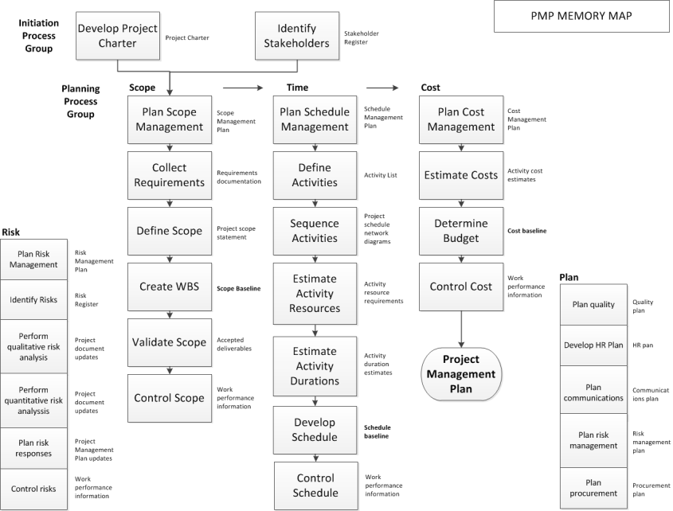
Notes:
Overview of Initiation and Planning activities (also includes some M&C activities).
Scope > scope baseline
Time > schedule baseline
Cost > cost baseline (budget)
All three help create the Project Management Plan.
It is easier to make changes in the beginning i.e. planning

Slide 6
Project Cost Management
Planning
Monitor & Control
Notes:
Cost management activities
Plan Cost Management – established the policies, procedures, and documentation for planning, managing, expending, and controlling project costs.
Estimate Costs- developing an approximation of the monetary resources needed to complete project activities.
Determine Budget- aggregating the estimated costs of individual activities (or work packages) to establish an authorized cost baseline.
Control Costs- monitoring the status of the project to update the costs and managing changes to the cost baseline.
Know the inputs, tools and outputs for the quiz

Slide 7
Estimating Cost Techniques
Analogous Estimating
Parametric Estimating
Three Point Estimating (PERT)
Bottom-up Estimating
Rough Order of Magnitude (ROM)
Activity Cost Estimates
Notes:
Analogous- using another similar project to estimate the new project.
Limited amount of information.
Less time.
Less costly.
Less accurate.
Parametric- statistical relationship between historical data and other variables.
Higher accuracy
More flexible than analogous
PERT
(O+4L+P)/6
Accounts for risk - benefit
Bottom-up estimating
Estimate at work package level and roll up – more accurate, most preferred method and people are more comfortable using it.
ROM
+ or – 50% in the initial stages (back of the envelope) for feasibility – high level estimate, back of the envelope/napkin estimate, very very early stages, to determine if its feasible
ACE
Estimating at the work package level (can be rolled up). - + or – 10%, very accurate, use as you get deeper in.

Slide 8
Direct and Indirect Costs
Direct Costs- Directly related to the project and can be controlled
Indirect Costs- Overhead costs that are occurred because of the project
Notes:
Direct
Example: materials, labor, engineering etc.
Indirect
Example: Landscape maintenance, facility security, etc.

Slide 9
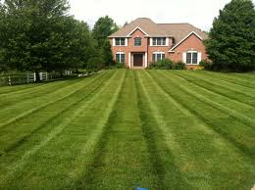
Lawn Mowing and Earned Value
$10
30 minutes
30 minutes
30 minutes
Notes:
#1: at budget, at schedule
#2: behind schedule, over budget (will cost more because behind)
#3: ahead of schedule, under budget (done fast than expected)
EVM looks at:
How much work has been done (earned value)
Schedule performance (ahead or behind what we planned)
Cost performance (spending more or less than we planned on)
Earned Value- measure of work performed expressed in terms of the budget authorized for that work.

Slide 10
EVM: Scenario
The project has 4 activities (ABCD)
Each activity should cost $10,000
The planned time for each activity is 1 month, 4 months total
Notes:
Slide 1 of example
This is what we planned on.
BAC – Budget at completion.

Slide 11
EVM: Execution
Notes:
Slide 2 of example:
What can we tell from these graphs?
3 months have passed
Activities A and B have been completed, C and D have not
We have spent $40,000 so far on the project
Over budget by
Behind schedule

Slide 12
EVM: Variance
Cost Variance: CV = EV - AC
Schedule Variance: SV = EV - PV
Notes:
Use formulas to determine the information you need to know.
CV = -20,000, over budget (negative number)
SV = -10,000, behind schedule (negative number)
EVM = measure of value we have created or amount of work we have done.
Formula or solve the equations for quiz. You can get graphs asking if your behind schedule or ahead of schedule.

Slide 13
EVM: How Much Longer
Estimate at Completion: EAC = AC / %Complete (or BAC-EV)
Estimate to Completion: ETC = EAC – AC
Variance at Completion: VAC = BAC - EAC
Notes:
EAC = 40,000 / .5 = 80,000
ETC = 80,000 – 40,000 = 40,000 *assumes remaining work will be performed on schedule or reestimate
VAC = 40,000 – 80,000 = -40,000 40,000 over budget
EVM: How Much Longer - How much it is going to cost us if we continue?

Slide 14
EVM Performance
Cost Performance Index: CPI = EV/AC
Schedule Performance Index: SPI = EV/PV
Notes:
CPI- Measure of cost efficiency of budgeted resources, expressed an a ration of earned value to actual cost.
<1 is bad (over budget), > 1 is good
SPI- Measure of schedule efficiency expressed as the ratio of earned value to planned value.
<1 is bad (behind schedule)
Great for doing performance reporting on projects (PMO).
EVM Performance – Which project managers have managed the best?

Slide 15
EVM Exercises
If EV = 30,000, PV = 40,000, and AC = 25,000?
What is the SV?
If EV = 100,000, PV = 120,000, and AC = 110,000
What is the CV?
If the BAC is 10000, the EAC is 5000, and the ETC is 4000
What is the VAC?
If EV = 40,000, PV = 50,000, and AC = 20,000
What is the CPI?
Notes:
Draw graphs and use formula to determine the solution.
SV = EV – PV = -10000
CV = EV – AC = -10000
VAC = BAC – EAC = 5000
CPI = EV/AC = 40000/20000= 2

Slide 16
Earned Value Formulas
Notes:
Know these formulas for the tests.
know these formulas and concepts for quiz and finals.

Slide 17
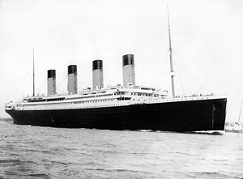
Case Study 2
Notes:
How can we apply the lessons learned form the Titanic today?
Keep expectations at check.

Slide 18
Group Project
Create budget
Complete project budget baseline

Slide 19
Project Budget
Create a budget for your project with cost by activity (at the appropriate level) and time period.
For your project scenario, assume that you are half way done. Create a snapshot of your project using the earned value formulas below.
Summarize your status and explain what you need to do, if anything, to adjust the plan.
EV
PV
AC
CV
SV
CPI
SPI
EAC
ETC
VAC
BAC

Slide 20
Preparing for the PMP/CAPM Exam

